Slide 1

Domain I
Agile Framework
16 % of PMI-ACP Exam
19 Questions

Slide 2
Agile Framework
Creating an Agile Mindset: Agile Manifesto , Principles
Agile Methodologies: Scrum, XP, Lean Kanban, DSDM, Crystal, FDD,ASD,AUP,DDD,TDD

Slide 3

Agenda
Creating an Agile Mindset
Agile Methodologies
Scrum
XP
Lean Kanban
DSDM
Crystal
FDD
ASD
AUP
DDD
TDD

Slide 4
Creating an Agile Mindset
Agile Manifesto , Principles

Slide 5
Agile Principles & Mindset Tasks
Advocate for agile principles and values in the organization
Ensure common understanding of agile principles
Educate and influence agile
Transparency equates to trust
Safe environment for experimenting
Experiment with new techniques and processes
Share knowledge new collaboration
Emergent leadership
Practice servant leadership

Slide 6
Why Agile?
Reduce turnaround time for features
Predictability of Market Releases > Content Timing
Ability to handle complex product enhancements
Project priorities change
Need to respond to customer requirements and market dynamics
Promote team work and less reliance on individual heroics
Course corrections and continuous improvements

Slide 7
Why Agile Methods?
Why do we need another approach for managing projects?
Different types of projects use different approaches
Value of customizing our approach to different situations often in small ways. We don't resolve every issue the exact same way, instead, we adjust our approach to be effective for the unique situation. The same concept applies to how we manage our project.
Some projects, especially knowledge worker projects occurring in fast moving or time-constrained environments, call for an agile approach
Predictive project plan up front - Industrial
Knowledge work has many unknowns

Slide 8
Knowledge work projects are different
Industrial work requires up-front planning
Knowledge work expects change
Knowledge work is invisible work
Agile is best suited for software development projects

Slide 9
Contrast Industrial Vs Knowledge Projects
Industrial | Knowledge
Visible Stable Running things Structure Correct answers Task driven Command and control Standards Performance measurement Cost of workers for a task | Invisible Lots of changes Changing environment Less structure Lots of questions Value-driven Autonomy driven Innovation Learning and teaching Workers are an asset not a cost

Slide 10
Defined Vs Empirical Process
Industrial work relies on defined processes
Knowledge work relies on empirical processes
A Defined process defines all steps in advance, same output is expected every time the process is followed, best suits for “Simple” and “Complicated” problem domains
An Empirical processes are interactive, incremental, change often, adapt, and pass through the reviews, Empirical processes are change-driven

Slide 11
Why Agile Methodology is empirical in nature?
Course correction at frequent intervals
Regular customer feedback
Failure detected early and hence early adoption of corrective measures
Status is visible to all stakeholders in a consistent way

Slide 12
Agile Manifesto
Meeting at Snowbird resort by 17 software pundits and light weight methodologists, February 2001. Created “Agile Manifesto”
We are uncovering better ways of developing software by doing it and helping others do it. Through this work we have come to value. i.e., Agile Values
Individuals and interactions over processes and tools
Working software over comprehensive documentation
Customer collaboration over contract negotiation
Responding to change over following a plan
That is, while there is value in the items on the right, we value the items on the left more.
Author:- Kent Beck, Mike Beedle, Arie Van Bennekum, Alistair Cockburn,
Ward Cunnigham, Martin Fowler, James Greening, Jim Highsmith, Andrew Hunt, Ron Jerries, Jon Kern, Brian Marick, Robert C.Martin, Steve Mellor, Ken Schwaber, Jeff Sutherland, Dave Thomas

Slide 13
Individuals and Interactions over process & tools
Individuals and interactions are most important
Processes and tools will be needed on projects
Projects are completed by people not processes and tools
Agile projects are people driven

Slide 14
Working Software over comprehensive documentation
Agile project need to deliver value
Value is about the purpose or business need the project aims to deliver
Documentation is barely sufficient
Documentation is done just in time –as the last responsible moment
Documentation might also be just because
Industry requirements
Organizational requirements

Slide 15
Customer Collaboration over contract negotiation
Agile is flexible, accommodating, and willing to change
Contracts are often rigid and uncooperative
Agile contracts must accommodate change
There’s a difference between being right and doing the right thing

Slide 16
Responding to Change over following a plan
Agile welcomes change
Predictive projects plan everything in advance
Agile projects have lots and lots of many changes
Agile projects have uncertainty up front

Slide 17
12 Principles behind Agile Manifesto
No | Principle | Shortened Version
1 | Our highest priority is to satisfy the customers through early and continuous delivery of valuable software | Customer Satisfaction
2 | Welcome changing requirements, even late in development. Agile processes harness change for the customer's competitive advantage. | Welcome Changes
3 | Deliver working software frequently, from a couple of weeks to a couple of months, with a preference to the shorter timescale. | Deliver Frequently
4 | Business people and developers must work together daily throughout the project. | Work with business
5 | Build projects around motivated individuals. Give them the environment and support they need, and trust them to get the job done | Motivated People
6 | The most efficient and effective method of conveying information to and within a development team is face-to-face conversation. | Face to Face Communication

Slide 18
12 Principles behind Agile Manifesto
No | Principle | Shortened Version
7 | Working software is the primary measure of progress. | Measure Software Done
8 | Agile processes promote sustainable development. The sponsors, developers, and users should be able to maintain a constant pace indefinitely. | Maintain Sustainable Pace
9 | Continuous attention to technical excellence and good design enhances agility. | Maintain Design
10 | Simplicity –the art of maximizing the amount of work not done is essential | Keep it Simple
11 | The best architectures, requirements, and designs emerge from self-organizing teams. | Team creates Architecture
12 | At regular intervals, the team reflects on how to become more effective, then tunes and adjusts its behavior accordingly. | Reflect and Adjust

Slide 19
Declaration of Interdependence
We increase return on investment by making continuous flow of value our focus
We deliver reliable results by engaging customers infrequent interactions and shared ownership
We expect uncertainty and manage for it to iterations anticipations and adaptation
We unleash creativity and innovation by recognizing that individuals are the ultimate source of value and creating an environment where they can make a difference
We boost performance through group accountability for results and shared responsibility for team effectiveness
We improve effectiveness and reliability through situationally specific strategies processes and practices

Slide 20
Agile Methodologies
Agile Methodologies: Scrum, XP, Lean Kanban, DSDM, Crystal, FDD,ASD,AUP,DDD,TDD

Slide 21
Agile Methodologies
Methodologies | Information
Scrum | Most popular agile methods Strongly codified set of ceremonies, roles and artifacts
XP | Foremost of agile methodologies Strong set of technical practices
Lean Kanban | Lean - Set of principles evolved from manufacturing to eliminate waste Kanban literally means a “signboard” or “billboard” and it espouses the use of visual aids to assist and track production. Lean Kanban integrates the use of the visualization methods as prescribed by Kanban along with the principles of Lean creating a visual incremental evolutionary process management system.
DSDM | Offshoot of Rapid Application Development Methodology Cost | Quality/time fixed and requirements prioritized as per MOSCOW
Crystal | Principles are categorized according to criticality and size of the project. Critical Levels: Comfort ( C )| Discretionary Money | Essential Money ( E ) | Life ( L )
Feature Driven Development | Plan | Develop and build by feature

Slide 22
Agile Methodologies..
Methodologies | Information
Adaptive Software Development (ASD) | ASD are constant adaptation of processes to the work at hand, provision of solutions to problems surfacing in large projects, and iterative, incremental development with continuous prototyping.
Agile Unified Process (AUP) | AUP combines industry-tried-and-tested Agile techniques such as Test Driven Development (TDD), Agile Modelling, agile change management, and database refactoring, to deliver a working product of the best quality
Domain-Driven Design (DDD) | Domain-driven design is an Agile development approach meant for handling complex designs with implementation linked to an evolving model.
Test Driven Development | Test Driven Development is a software development method that involves writing automated test code first and developing the least amount of code necessary to pass that test later.

Slide 23





Scrum
Jeff Sutherland | Ken Schwaber
Mike Cohn | Nanda Lankalapalli | SRIRAM Balasubramanian
SCRUM FOUNDERS
SCRUM ALLIANCE GURUS
Scrum Intro | Roles | Ceremonies |Artifacts

Slide 24
Scrum Intro
Scrum is easy to understand, but can be difficult to master
Scrum is a rugby term
Scrum uses a methodology called the scrum framework
The scrum framework is a set of practices, roles and responsibilities, events, artifacts, and rules

Slide 25
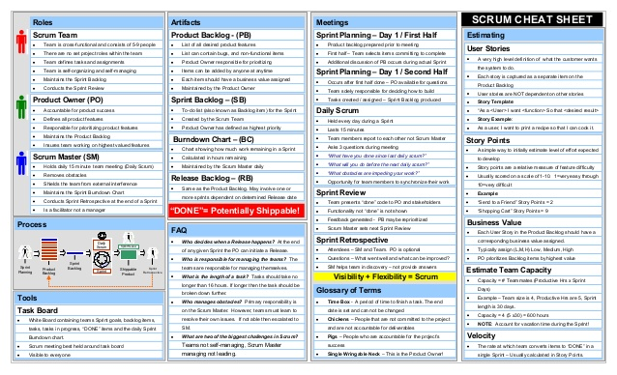
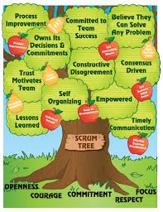
Scrum in a page

Slide 26
Scrum in 100 words
Scrum is an agile process that allows us to focus on delivering the highest business value in the shortest time.
It allows us too rapidly and repeatedly and repeatedly inspect actual working software in every two weeks.
The business set the priorities. Team self-organize to determine the best way to deliver the highest priority features.
Every two weeks to a month anyone can see the real working software and decide to release it as is or continue to enhance it for another sprint.

Slide 27
Characteristics of Scrum
The most popular ‘Agile Processes’ in Agile software development
A project management/execution process framework
Well suited for projects that require Empirical process control
Focuses on self-organizing teams
Requirements are captured in a prioritized list (Product Backlog)
Product progresses in a series of month-long “sprints”
No specific engineering practices prescribed
Uses generative rules to create an agile environment for delivering projects

Slide 28
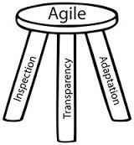
Scrum Pillar & Values
Transparency –a common understanding of what done means in a scrum project
Inspection –reviewing the project to determine the completeness of the project; finding root cause of variances from the project goals
Adaptation –making adjustments to the scrum process to mitigate problems or bad trends

Slide 29
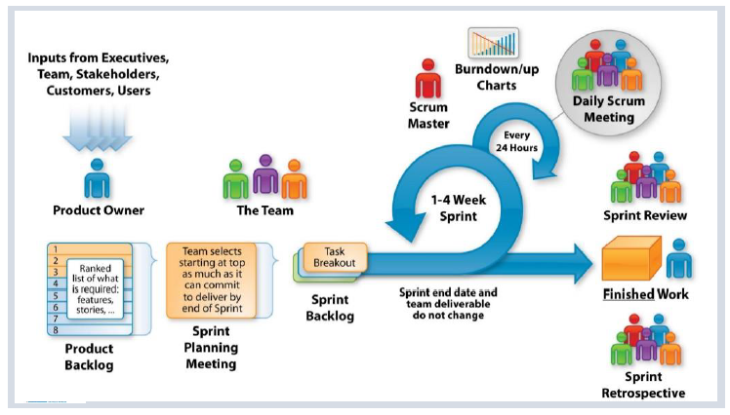
Scrum Framework

Slide 30
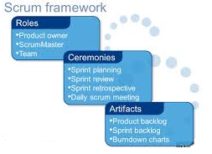
Scrum Framework

Slide 31
Sprints
Scrum projects make progress in a series of “Sprints”
Timebox iteration for project work. A timebox is a predetermined duration
Scrum sprints are between two to four weeks in duration. A constant duration leads to better rhythm
During a sprint no changes are made that would affect the goal of the sprint
A sprint can be cancelled if they change in the project goals make the sprint goals obsolete .Only the product owner may cancel a sprint
If a sprint is cancelled, uncompleted backlog items are returned to the product backlog
The development team members are kept the same throughout the sprint , team members has to update the sprint backlog and attend the daily scrum meeting
Within a sprint there are several activities:
Sprint planning meeting
Development
Daily scrums
Sprint review meeting
Sprint retrospective meeting

Slide 32
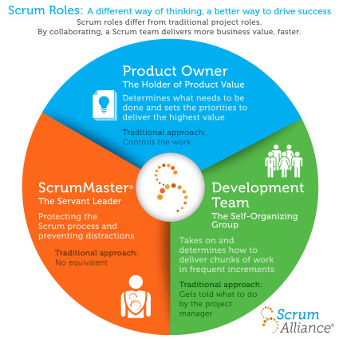
Scrum Roles
Scrum Master –Responsible for communicating the scrum methodology and ensuring the methodology is used effectively
Product owner –Prioritizes the product backlog to ensure value from each sprint
Development team –The software developers who create the product through the sprint

Slide 33
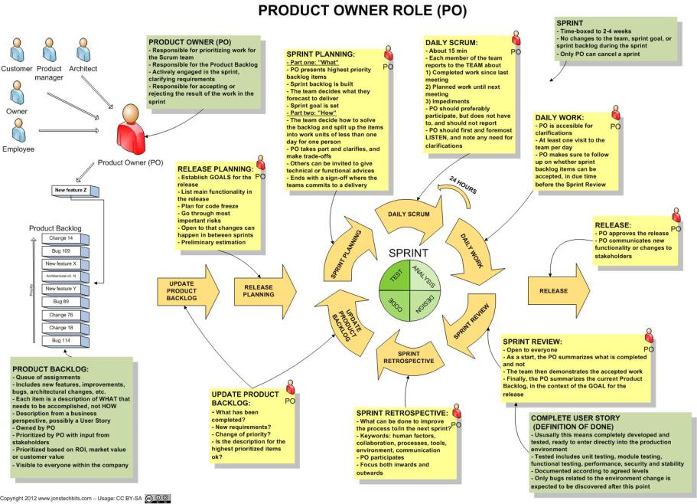
Product Owner

Slide 34
Product Owner
Defines the feature of the product
Decide on release date and content
Be responsible for the profitability of the product (ROI)
Prioritize features according to the market value
Adjust features and priority every iteration, as needed
Accept or reject work results
Maintains and grooms the Product Backlog
An effective product owner is Committed, Responsible, Authorized, Collaborative, and Knowledgeable (CRACK)

Slide 35
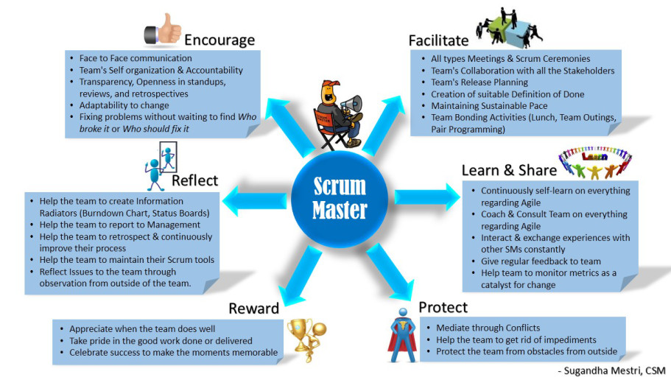
Scrum Master

Slide 36
Scrum Master
Represents management to the project
Responsible for enacting Scrum rules, values and practices and censure team members and stakeholders not adhering to these rules ad norms
Removes impediments
Ensure that the team is fully functional and productive
Enable close co-operation across all roles and functions
Shield the team from external interferences
Practices “Servant Leadership” – Facilitator and enabler rather than a Manager

Slide 37

Development Team
Typically 4 – 9 people. Ideally 7+/- 2 (Note: Scrum Master & Product Owner Excluded)
Cross functional – Programmers, testers, user experience designers, etc.,
Members should be full-time – May be exceptions for DBA’s
Teams are self-organizing (No titles)
Membership should change only between sprints

Slide 38
Scrum Ceremonies
Scrum activities are also known as events or ceremonies
There are five scrum ceremonies:
Product backlog refinement | grooming
Sprint planning meetings
Daily scrum
Sprint reviews
Sprint retrospective

Slide 39
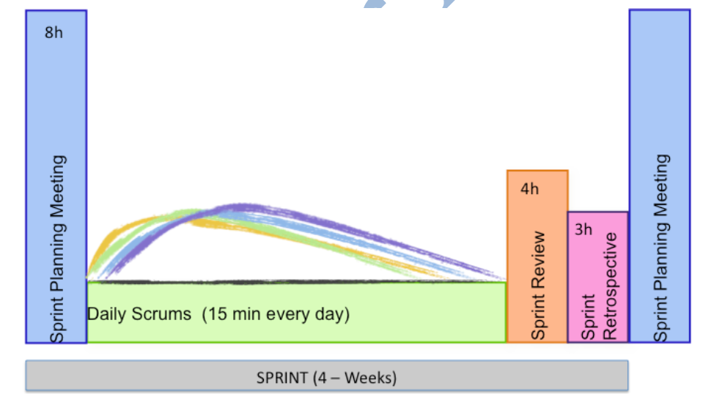
Scrum Ceremonies Timeboxing

Slide 40
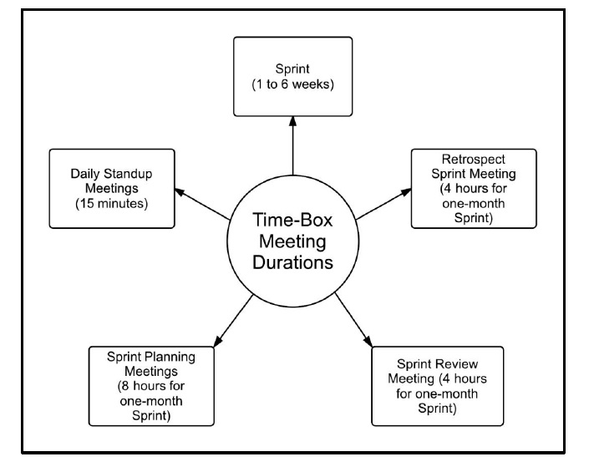
Scrum Ceremonies Timeboxing
Time box is the maximum time allowed for an event
Time box makes teams focus on most important things first
All Scrum events are time boxed. Sprints are time boxed at 1-6 weeks
Timeboxing for scrum ceremonies:
Sprint
Sprint planning meetings
Daily scrum
Sprint reviews
Sprint retrospective

Slide 41
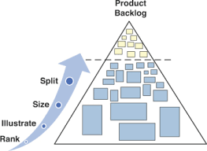
Product Backlog Refinement | Grooming
Product backlog refinement is the process through which product backlog items are reviewed by the Scrum team and revised, providing more detail and ensuring that there is greater clarity in the requirements for that item
The product owner owns the backlog
Backlog refinement is the prioritization backlog items
The entire project team may participate in the backlog grooming

Slide 42
Product Backlog Refinement | Grooming
Scrum has an activity called “Product Backlog Refinement” to progressively elaborate the product backlog
Primary goal of product backlog refinement is to get ready with few items for upcoming one or two sprints
Product Backlog items that are refined are deemed “Ready” for selection in a Sprint Planning
Product Backlog Refinement is the act of adding detail, estimates and order to items in the Product Backlog
Product Backlog Refinement is an ongoing activity throughout a Scrum project
Team and PO decide the frequency and duration of backlog refinement meeting. However, it is time boxed at 10% of total available time.

Slide 43
Sprint Planning
Product Owner and Project team needs to discuss the goals of the upcoming sprint
Product Owner and team negotiates stories to select in current sprint from prioritized product backlog for the upcoming sprint
Selected stories are estimated with agreed acceptance criteria
Team identifies and estimates Task, discusses how the work will be accomplished
Scrum Master, Product Owner and team can attend the meeting
Product Backlog has to be groomed by PO prior to sprint planning meeting, Product owner reviews with the team items in the updated backlog
Self-organized Development team defines how the work will be done in the goals of the sprint will be achieved
Normally split into 2 sets of 4 hours each Timebox: Max 8 hours per sprint
First half for choosing the product backlog items with PO
Second half for splitting into tasks and assignment (Product Owner is optional for the second half)
Artifacts – Sprint Goal , Sprint Backlog (Output of Sprint Planning)

Slide 44
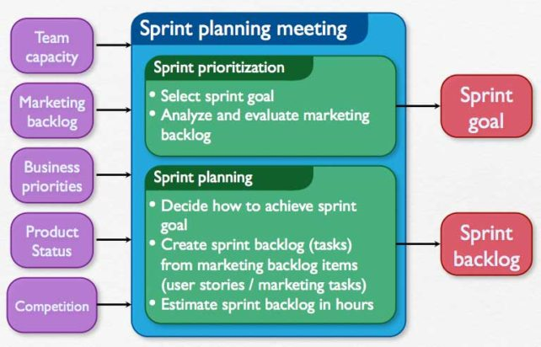
Sprint Planning
Input: Refined Product Backlog | Latest Product Increment | Team Capacity
Outcome: Sprint Goal | Sprint Backlog

Slide 45
Daily Scrum
The daily scrum is also known as a stand-up meeting, typically first activity of the day
This is a 15-minute timeboxed meeting
The daily scrum is held every day at the same time and location
The whole world is invited
The daily scrum is for the development team only, facilitated by Scrum Master, Product Owner optional
This is not problem solving meeting. Pigs can talk, Chickens observe
Scrum Master to intervene to bring in discipline after due attempts at self-correction

Slide 46
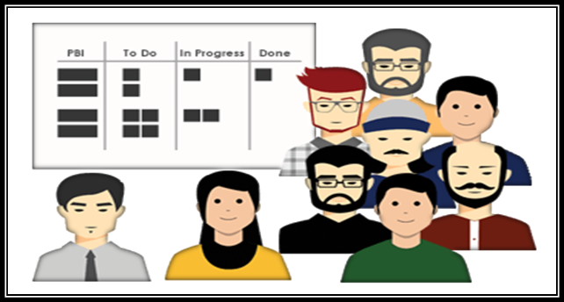
Daily Scrum
Daily Scrum Meeting Questions for the team members
What have I done since the last daily scrum?
What do I plan to do today?
Are there any impediments to my progress?
Input: Sprint Backlog
Outcome: Updated Sprint Backlog

Slide 47
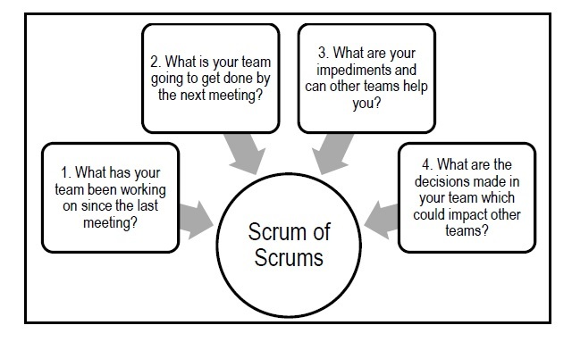
Working with Large Scrum Team
Scrum of scrums
Scrum of scrums of scrums
Four questions are answered:
What has your team done since we last met?
What will your team do before our next meeting?
Are there any roadblocks in your team’s way?
Will your team put anything in another team’s way?

Slide 48
Sprint Review
Team presents what it accomplished during the sprint, typically takes the form of a demo of new features or underlying architecture. Done from QA server (Close to Prod)
Hosted at the end of every sprint Timebox: Max 4 hours per sprint
Attendees will be the development team, the product owner, scrum master, and sometimes other project stakeholders
The development team will demo the work created in the increment
The group will decide if “Done” has been achieved
Stakeholders can provide comments which go in to the product backlog
The development team and the product owner will discuss the sprint and the remaining items in the product backlog further procced with

Slide 49

Sprint Review
Input: Product Increment
Outcome: Product Backlog (Revised)

Slide 50
Sprint Retrospective
The development team meeting posted after the sprint review, but before the next sprint planning meeting
Periodically take a look at what is and is not working
This is a meeting to inspect an adapt Timebox: Max 4 hours per sprint
Lessons learned and opportunities for improvement
Review of the product owner’s feedback about the last iteration
An opportunity to improve on their approach based on the retrospective and the last sprint

Slide 51

Sprint Retrospective
Input: Feedback | Experience of team members
Outcome: List of improvements

Slide 52
Scrum Artifacts
Product Increment
Product Backlog
Sprint Backlog

Slide 53
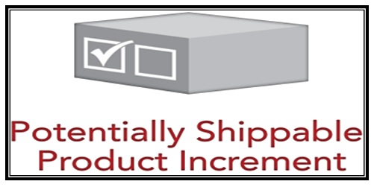
Product Increment
Every sprint produces a product increment, the sum of product backlog items delivered in each sprint is called as Potentially Shippable Product Increment. A product increment is the “goal line” for each sprint and, at the end of the sprint, it must:
Be of high enough quality to be given to users
Meet the scrum team’s current definition of done
Be acceptable to the product owner with properly tested, completed in full shape and ready to use
The product increment is the outcome of an iteration
The product increment is a chunk of the project work
The development team and the product owner must be an agreement of what done means for an increment

Slide 54
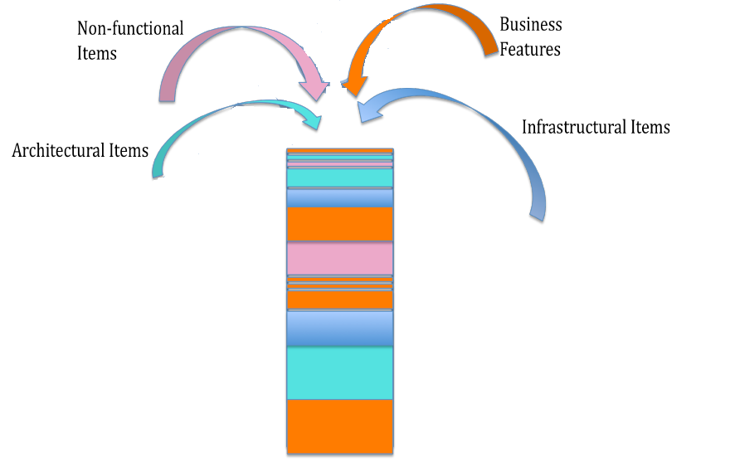
Product Backlog
List of things that needs to be done to make the product come into existence
The product backlog is the source for all product requirements
The product owner sorts and prioritizes the backlog items
The development team always works on the most important items based on the prioritized items in the product backlog
The backlog is always prioritized before the current sprint
Backlog refinement is done by both the product owner and the development team working in harmony
The team estimates their capacity to attack the items in the product backlog

Slide 55
Product Backlog
What is Product Backlog?
The Product Backlog is an ordered list of everything that might be needed in the product and is the single source of requirements for any changes to be made to the product. The Product Owner is responsible for the Product Backlog, including its content, availability, and ordering. Items in the product backlog are called “Product Backlog Items (PBI)” Product Backlog contains all items required to accomplish the product vision.
Each product backlog item would have
Description – Details of the item
Value – What business value this item would provide
Estimate – Effort estimate to build this item
Order – The order in which the items should be worked in

Slide 56
Product Backlog
A Product backlog is simply a prioritized list of all work items, classified as
Stories | Prioritized list of project requirements with estimates (in Story Points) to turn them into completed product functionality
Technical debts | Other items like engineering improvement goals, exploratory or research work and possible known defects with appropriate estimate.
Risks | Risks that are of anti-value, or factors that have a potential to erode, remove, or reduce value if they occur.
Fine-grained Backlog Items ready for next Iterations/ Iterations i.e. smaller user stories
High priority
Each iteration implement the highest priority requirements
Each new requirement is prioritized and added to the stack
Stories are classified as Epic and User Stories (i.e. bite-sized) based on priority and level of details available.
Stories and Epics can be bundled together to form theme.
Medium-grained Backlog Items for current Release
Requirements may be reprioritized at any time
Coarse-grained Backlog items for Future Releases i.e. Epics
Requirements may be removed at any time
Low priority

Slide 57
Product Backlog
A Product Backlog is best described as DEEP
Detailed Appropriately: Higher order items are more detailed and well understood compared to lower order items
Estimated: Product backlog items are estimated in relative size by the development team. Product owner orders the items based on the value and the cost
Emergent: Product Backlog is a living artifacts. It is always updated for details, estimates and order. The life of the product backlog is same as life of the product itself
Prioritized: Product backlog items are ordered based on the priority. The order is force ranking (1,2,3) so that there are no completing priorities

Slide 58
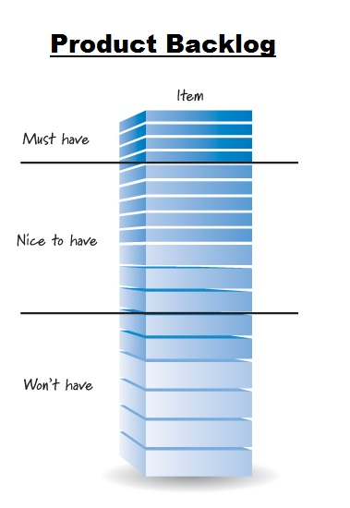
Product Backlog Prioritization Technique
Customer value prioritization is concerned with working on the items that yield the highest value to the customer as soon as possible.
MoSCoW is a technique used to prioritize stories into four distinct categories:
M – MUST have this Requirements that are fundamental to the system; without which system will not work and have no value and have to be included in the current delivery time box
S – SHOULD have this Requirements that is important for project success; Important as MUST have but not as time-critical or have a work around’s. In other words not necessary for delivery in the current delivery time box
C – COULD have this Requirements not necessary; can include if it increases customer satisfaction for little development cost
W – WON’T have this time, but WOULD like in the future Alternatively WANT – No to this release

Slide 59
Sprint Backlog
Like the product backlog the sprint backlog is a prioritization of the product
The sprint backlog is a subset of the product backlog
The sprint backlog serves as the goal for the current iteration
The sprint backlog is a view into the work to be accomplished in the current sprint
The sprint backlog is updated and refined by the development team

Slide 60
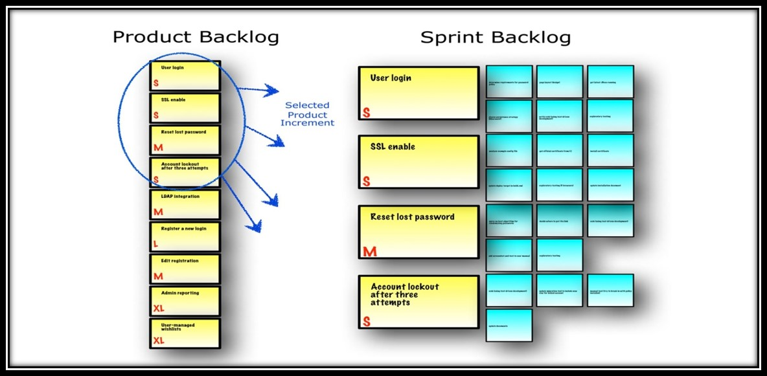
Sprint Backlog
What is Sprint Backlog?
The Sprint Backlog is the set of Product Backlog items selected for the Sprint, plus a plan for delivering the product Increment and realizing the Sprint Goal.

Slide 61
Sprint Goal
A short statement of what the work will be focused on during the sprint
It provides guidance to the Development Team on why it is building the Increment. It is created during the Sprint Planning meeting. The Sprint Goal gives the Development Team some flexibility regarding the functionality implemented within the Sprint. The selected Product Backlog items deliver one coherent function, which can be the Sprint Goal. The Sprint Goal can be any other coherence that causes the Development Team to work together rather than on separate initiatives.
As the Development Team works, it keeps the Sprint Goal in mind. In order to satisfy the Sprint Goal, it implements the functionality and technology. If the work turns out to be different than the Development Team expected, they collaborate with the Product Owner to negotiate the scope of Sprint Backlog within the Sprint.

Slide 62
Definition of Done
Definition of Done is a list of attractive activities agreed by the Product Owner and the Development Team to call a backlog item is done
A stronger DOD leads to higher quality product:-
Code Complete
Unit tests Written
Code Review
Manual Functional Testing
Automation
Updated Documents
User Acceptance Testing
Successful Deployment

Slide 63
Scrum Ownership | Responsibility
Item | Development Team | Product Owner | Scrum Master
Estimates | DT
Backlog Priorities |  | PO
Agile Coaching |  |  | SM
Velocity Predictions | DT
Definition of Done | Sprint Planning | DT | PO | SM
Process Adherence |  |  | SM
Technical Decision | DT

Slide 64
Product Vision
A product vision is created
The product must be in alignment with the company’s strategy
This is done by the product owner

Slide 65
Product Roadmap
The visualization of product features
The product roadmap equates to the product division as a whole
This is done and owned by the product owner

Slide 66
Release Planning
The release timing for specific product functionality
Priorities are assigned to the product features from most important to least important
These features become the product backlog
Owned by the product owner

Slide 67
Iteration Planning | Release Planning
Goals are established for the current Sprint or iteration
Goals are based on the product backlog
Product owner in the development team work together to prioritize features
This is done at the start of each Sprint
Released Product
The product is released according to the project’s release plan

Slide 68
XP
XP Life Cycle | XP Values |XP Team Roles | XP Core Practices | Technical Debt

Slide 69
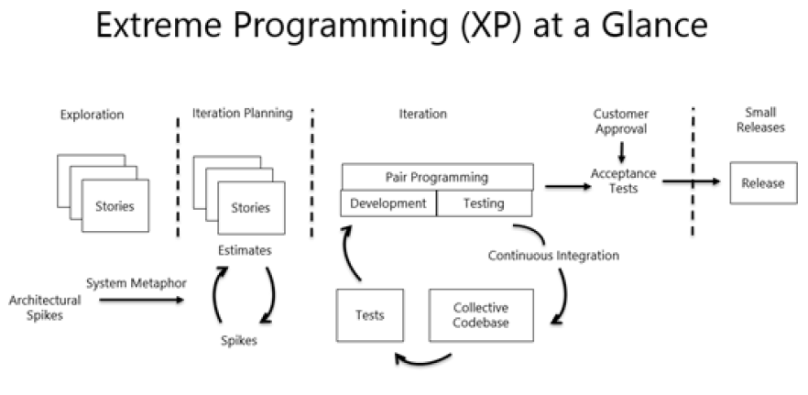
eXtreme Programming
Extreme programming is also known as XP
XP is all about software development best practices, while scrum at the project management level focuses on prioritizing work and getting feedback

Slide 70
XP Life Cycle

Slide 71
XP Values
Simplicity
Reducing complexity, extra features, and waste . Find the simplest thing that could possibly work
Communication
Ensuring that the project team knows what is expected of them
Ensuring the project team knows what other people are working on
The daily standup meeting is an excellent communication tool
Feedback
The development team needs feedback early in the project
Failing fast is a way to get feedback early
Feedback gives the team an opportunity to improve the project

Slide 72
Courage
Developers’ work is entirely visible to others on the project team
Team members share code and correct each other’s code
XP uses pair programming
Respect
Team members must respect one another
Everyone is responsible for the success and or failure of the project
Everyone works differently but must work together

Slide 73
XP Team Roles
Coach –Mentor/guide/facilitator/communicator similar to the Scrum Master
Customer –the individual who provides requirements priorities and direction for the project similar to the product owner
Programmer –the developers who write the code
Testers –Define and write the acceptability test

Slide 74
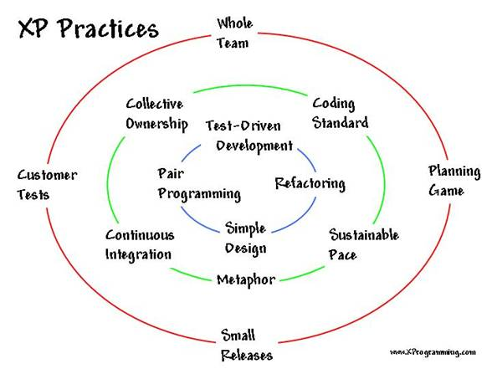
XP Core Practices

Slide 75
XP Core Practices..
Whole Team
XP team members are collocated
Generalizing specialist not role specialist
Efficient and sharing of information
Planning games
Planning games are just planning activities
Release planning is the release of new functionality
No more than one or two releases per year
The customer outlines the functionality required in the release
Developers estimate the difficulty to build the functionality
Iteration planning is similar to sprint planning
Iteration planning happens at the start of every iteration
The customer defines what functionality they want to see by the end of the iteration
The development team estimates the difficulty to build the functionality

Slide 76
XP Core Practices..
Small Releases
Small releases to a test environment are part of the XP practices
Increases visibility to the customer
Helps to deploy working software to the end users
Customer Tests
Definition of the required functionality
Description of one or more test criteria for the software to be working
Collective Ownership
Any pair of developers can improve or amend the code
Multiple people will work on all the code
Improve defect resolution in discovery
Knowledge is shared not isolated

Slide 77
XP Core Practices..
Coding Standard
A coding standard is defined
The team adheres to the standard
Provides for consistency in writing the code
Sustainable Pace
Productivity is optimized through a sustainable pace
Consistent overtime and long hours are not sustainable
Metaphor
Metaphors and similes are used to explain designs
Metaphors help communicate the software to the customer

Slide 78
XP Core Practices..
Continuous Integration
Compiling the code frequently throughout the day
Programmers check-in code to the code repository
Integration test run automatically for immediate feedback
Test Driven Development
Acceptance test are written prior to developing new code
Initial tests will fail because the code has not been fully developed yet
When the code has been written correctly it will pass the test
Refactoring
Cleaning up the code
Removing duplicated code
Lowering coupling
Increasing cohesion

Slide 79
XP Core Practices..
Simple Design
What is the simplest thing that could work?
Simple does not mean easy
Simple design is a risk mitigation approach
Pair Programming
One person writes the code while the second person reviews the code
The two people change roles frequently
The pair will catch mistakes and speed up productivity

Slide 80
Technical Debt
Technical Debt is the cost of shortcuts that accumulate over time, leading to:-
Increased risk
Slower time to market
Greater maintenance & enhancement cost

Slide 81
XP Chunk | Made-up Junk

Slide 82
Lean Kanban

Slide 83
Lean Product Development
Lean is a set of principles that have been taken from lean manufacturing approaches and applied to software development
Lean is not an agile methodology but agile values are closely aligned.
Toyota production system
Visual management tools
Customer to find value
Learning and continuous Improvement

Slide 84
Seven Lean Core Concepts
Eliminate waste
Empower the team
Deliver fast
Optimize the whole
Build quality in
Defer decisions
Amplify learning

Slide 85
Seven Wastes of Lean
Partially done work
Extra processes
Extra features
Task switching
Waiting
Motion
Defects

Slide 86
Lean Product Development

Slide 87
Match Agile Practices to Lean Development

Slide 88
Kanban
Japanese word that means sign board
The signboard has categories of work for each stage of the production process

Slide 89
5 Principles of Kanban
Visualize the workflow
Limit work in progress
Manage flow
Make process policies explicit
Improve collaboratively

Slide 90
Kanban Pull System
A pull system moves work through development
The development team completes an item; the next item in queue is pulled into the next stage of the process
Kanban does not use timeboxed iterations
Only so many items can be in each stage of the project
Work moves from left to right

Slide 91
Little Law
The duration of a queue is proportional to its size
By limiting the work-in-progress teams complete work faster

Slide 92
Feature Driven Development
The development team creates a model for the product
They will build a feature list and a plan for the work
The team moves through the design and build the directions for the product features
The team designs by features and builds by features

Slide 93
Feature Driven Development..
Domain object modeling
Developing by feature
Individual class code ownership
Feature teams
Inspections
Configuration management
Regular builds
Visibility of progress and results

Slide 94
Dynamic System Development Method
Focus on the business need
Deliver on time
Collaborate
Never compromise quality
Build incrementally from foundations
Develop iteratively
Communicate continuously and clearly
Demonstrate control

Slide 95
Dynamic System Development Method

Slide 96
Crystal
Customized methodologies coded by color names
Methodologies are appropriate for different criticalities and team sizes
Criticality is about the impact of a product defect design

Slide 97
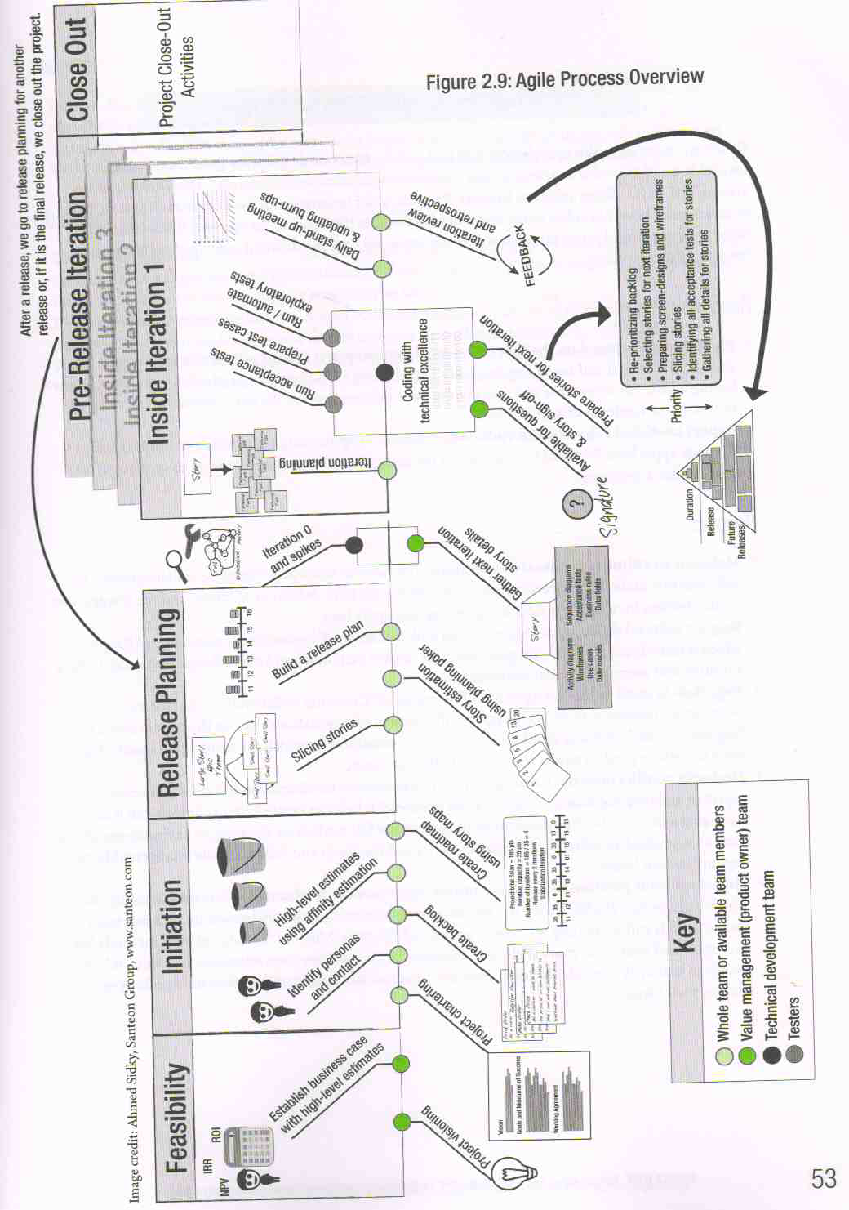
Agile Process Overview Chart

Slide 98
Professional Responsibility and Ethics
Responsibility
Make decisions based on the interests of the company
Protect proprietary information
Respect
Maintain the attitude of mutual co-operation
Respect cultural differences
Negotiate in good faith
Deal with conflict directly
Don’t use your position to influence others
Fairness
Look for and disclose conflict of interest
Don’t discriminate
Honesty
Understand the truth
Be truthful of all communications

Slide 99
Agile Leadership Practices
Honesty
Forward looking
Competent
Inspiring

Slide 100

Domain Completion
PMI-ACP
You have successfully completed –
Agile Framework domain

